Slide 1

“Visual Descriptors for Image Classification”
Mikołaj Leszczuk

Slide 2
Features in Computer Vision
Piece of information relevant for specified task
Referring to characteristic elements of image, for instance:
Absolute value between neighbor pixels
Specific kind of edges
Shapes of complex objects
Used to:
Identify objects, and
Understand image scene

Slide 3
Haar Features
Kind of features used in digital object recognition
Historically used intensity of pixels
Practically, first real-time implementation using Haar wavelets (by Viola and Jones)
Two steps of Haar-like feature detection:
Step 1:
Consider adjacent rectangular regions at specific location in detection window
Sum up pixel intensities in each region, and
Calculate difference between these sums
Step 2: Categorize subsections of image, based on calculated differences

Slide 4
Feature Descriptor
Instance of feature representation
Used to describe, detect and recognize visual object in image
Literature describing many feature description algorithm

Slide 5
Most Popular Feature Descriptors
SIFT (Scale-Invariant Feature Transform)
SURF (Speeded Up Robust Features)
HOG (Histogram of Oriented Gradients)
LBPH (Local Binary Pattern Histogram)
ORB (Oriented FAST and Rotated BRIEF):
FAST (Features from Accelerated Segment Test)
BRIEF (Binary Robust Independent Elementary Features)
MPEG-7 (Moving Picture Experts Group – 7)

Slide 6
MPEG-7 Audiovisual Descriptors (1/2)
MPEG-7 – much more than just metadata storage
Automatically generated compact description of multimedia content

Slide 7
MPEG-7 Audiovisual Descriptors (2/2)
Descriptors:
Visual descriptors (color, texture, shape/object, motion, localization, other)
Audio descriptors
Allow for clustering images with some similar features

Slide 8
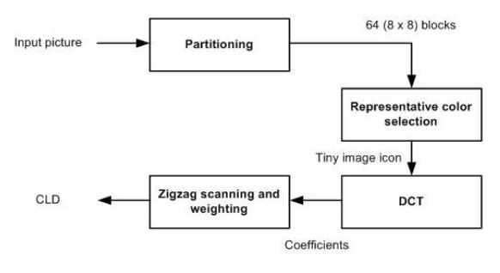
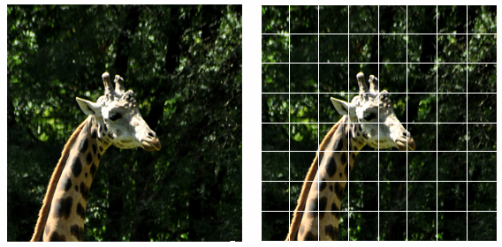
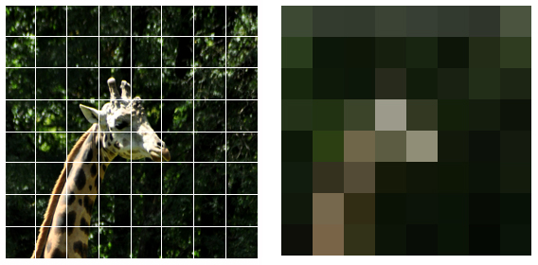
Seven MPEG-7 Colour Descriptors
Colour Space Descriptor
Colour Quantization Descriptor
Dominant Colour(s) Descriptor
Colour Layout Descriptor (example provided)
Colour Structure Descriptor
Scalable Colour Descriptor
GoF/GoP Colour Descriptor

Slide 9
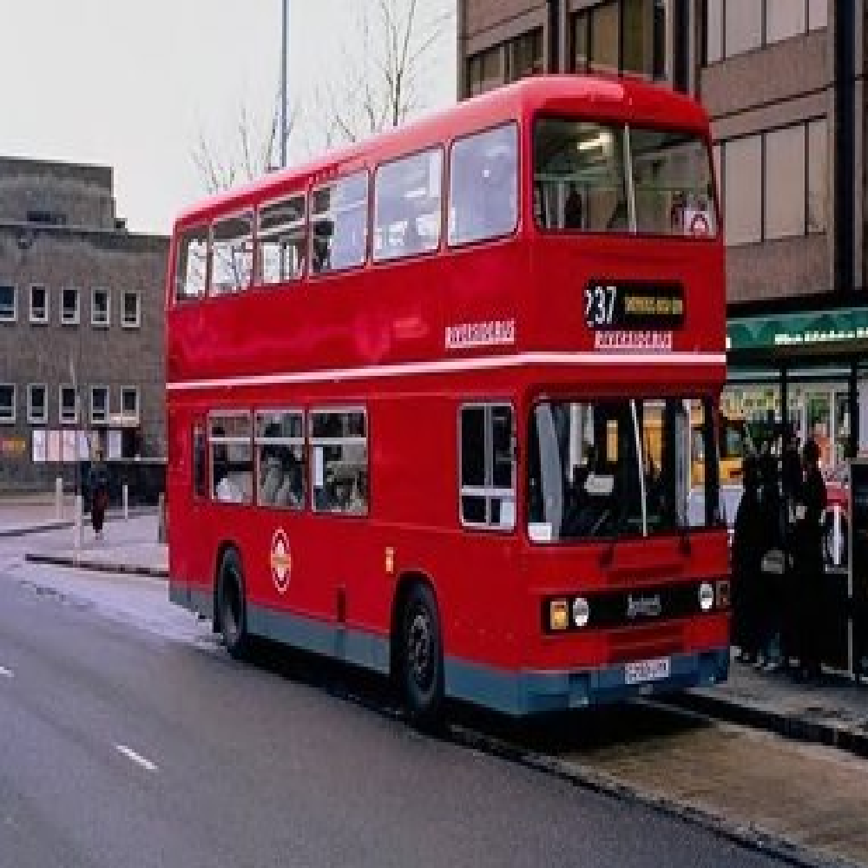
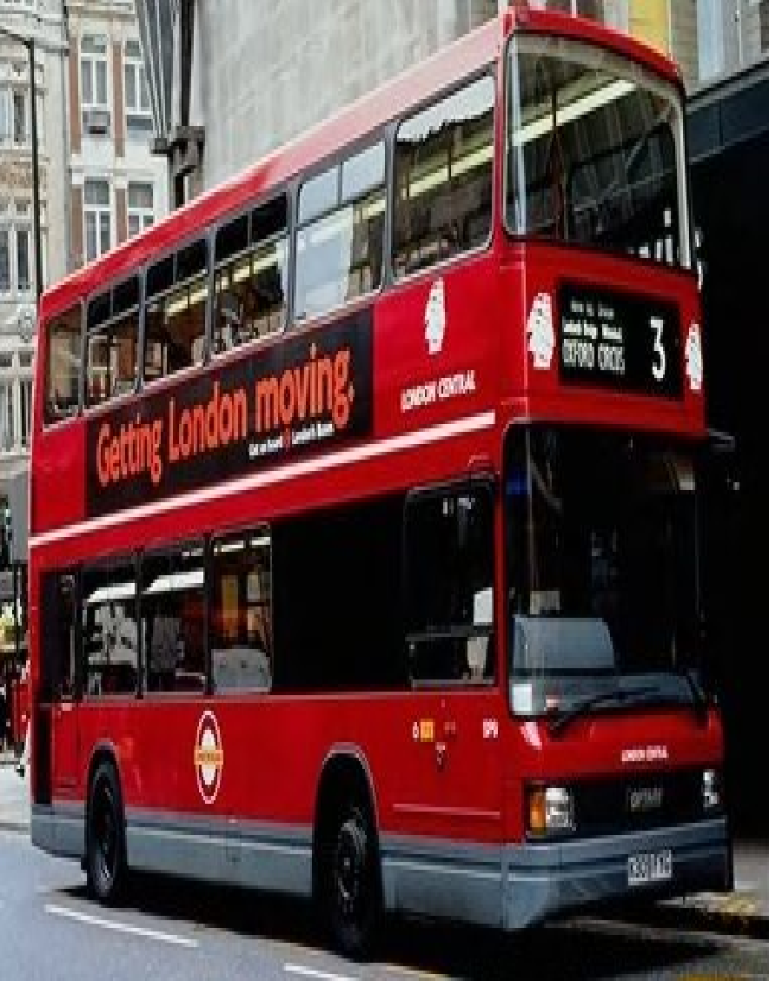
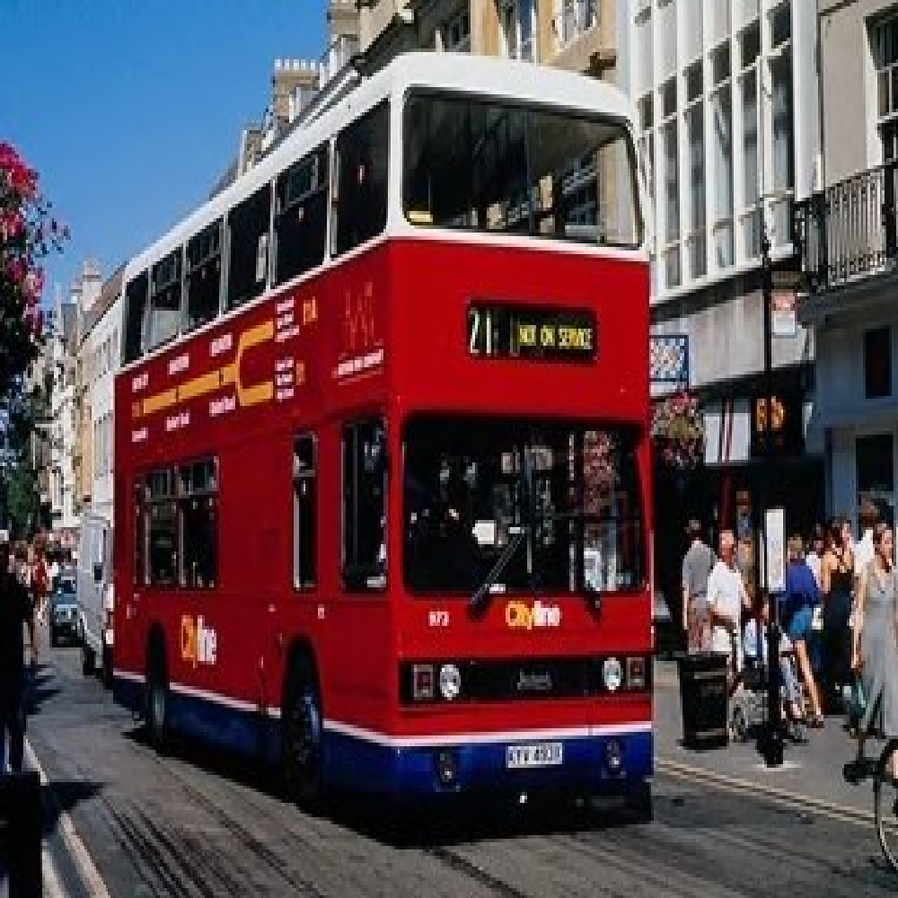
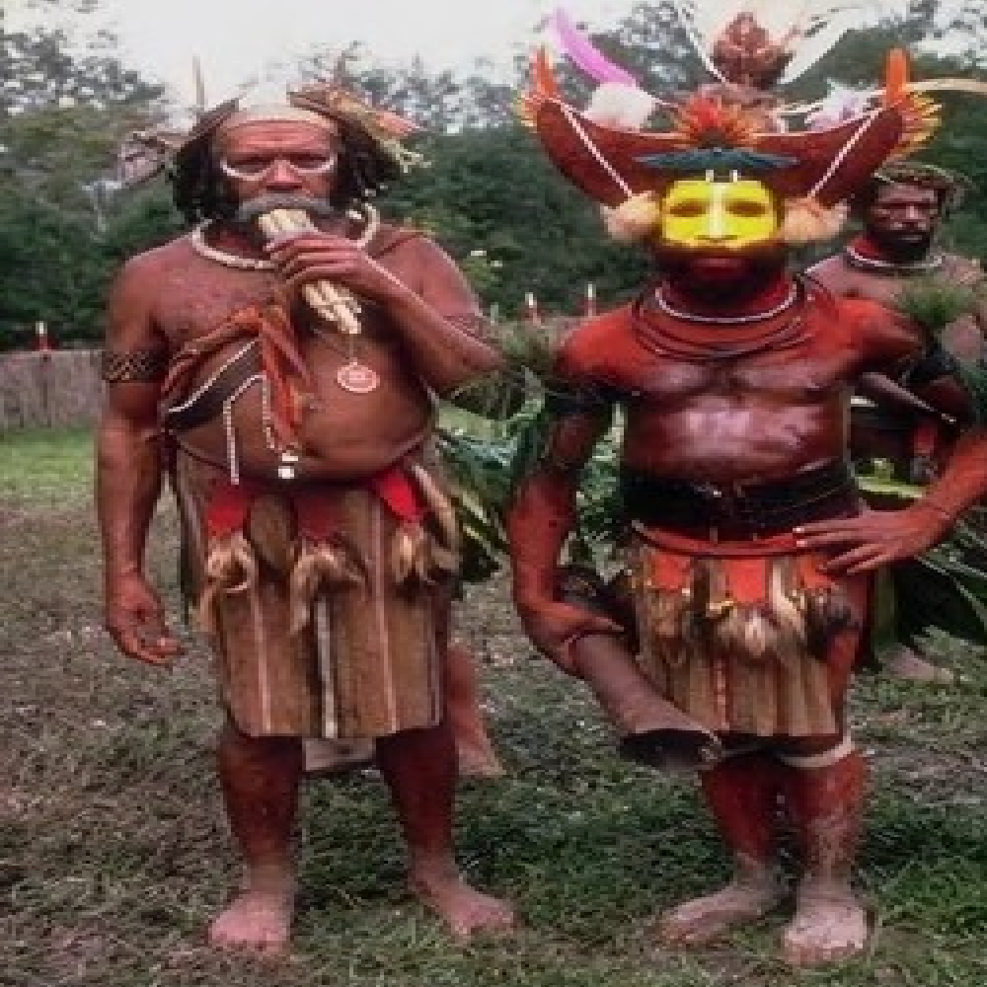
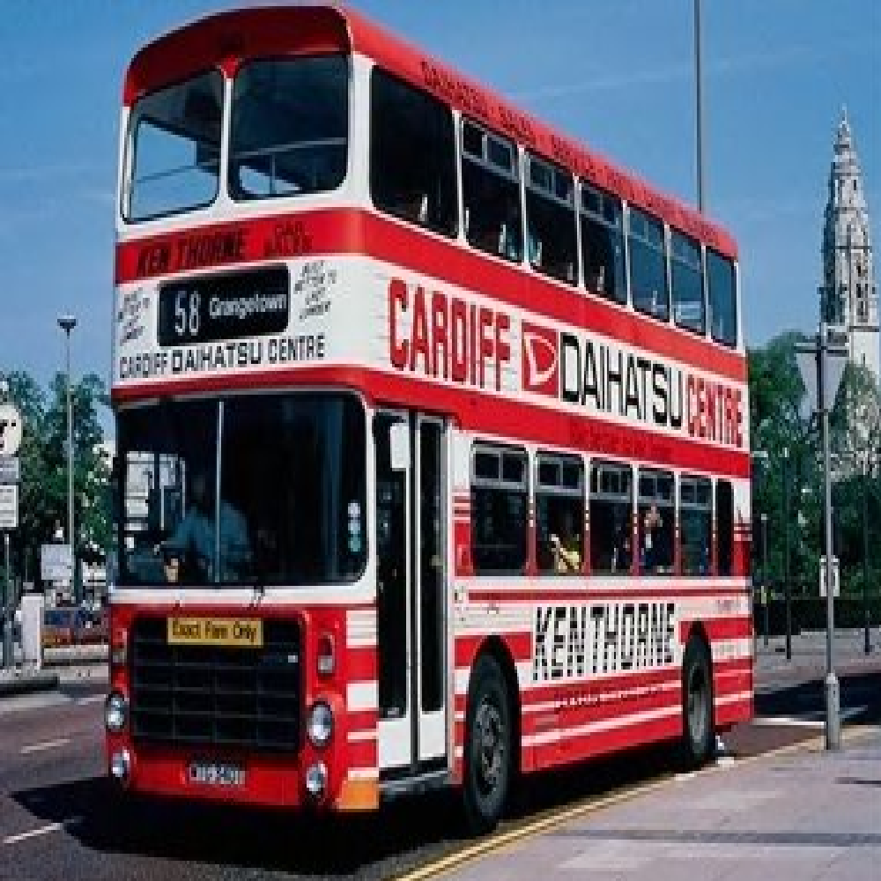
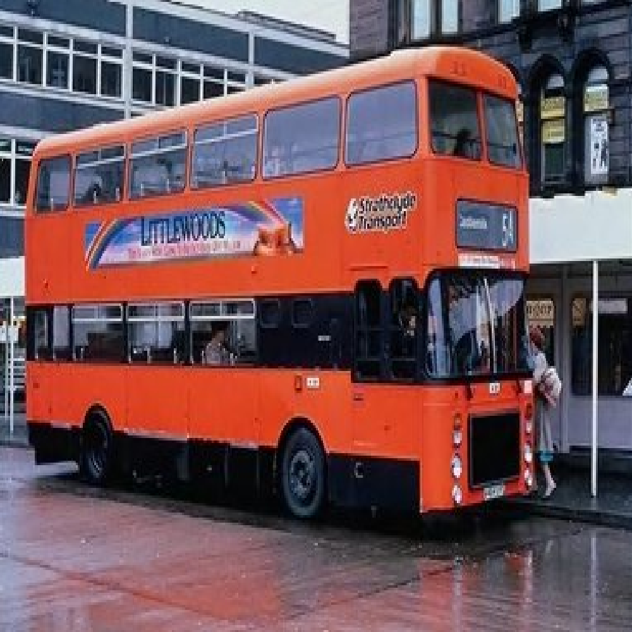
Examples of MPEG-7 Colour Descriptors Searching (1/2)
Dominant Colour(s) Descriptor
Colour Layout Descriptor

Slide 10
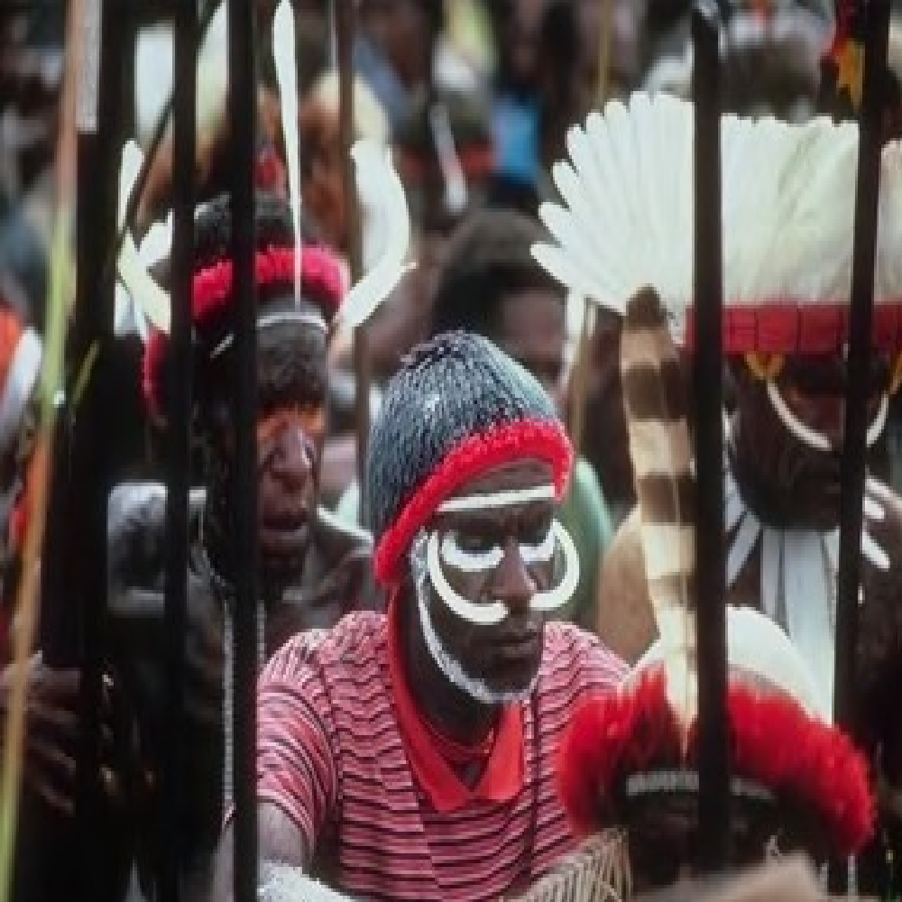
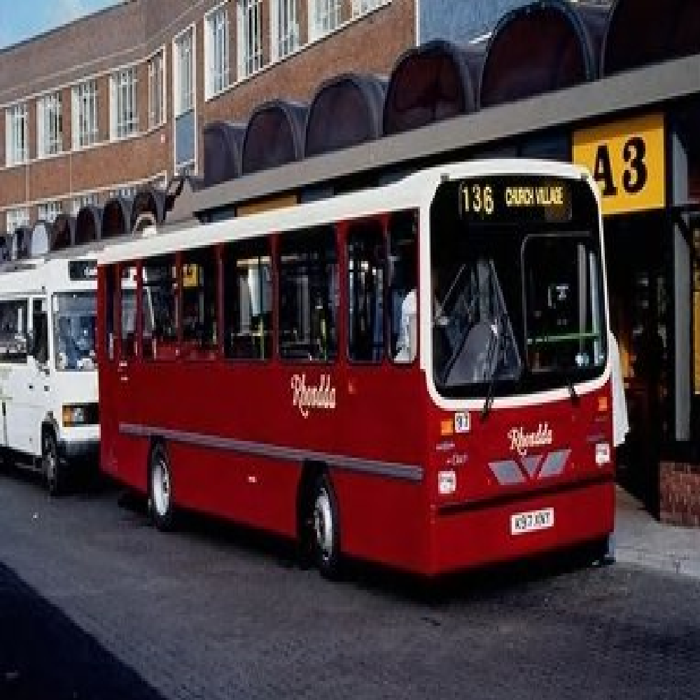
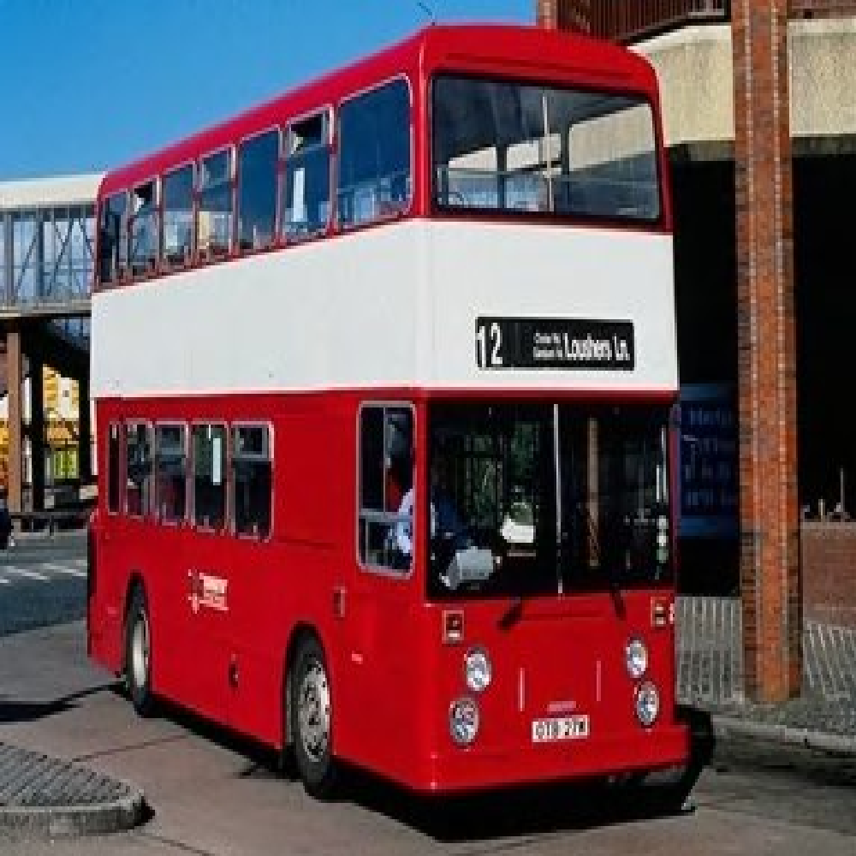
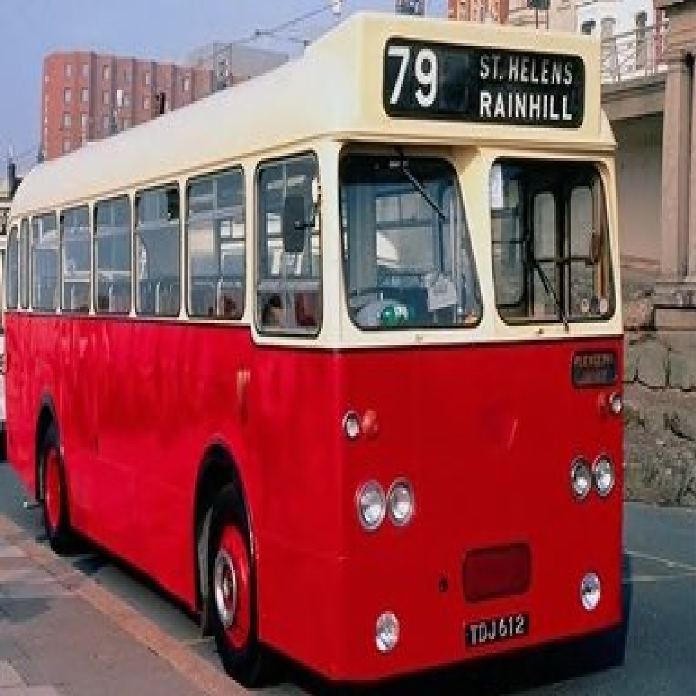
Examples of MPEG-7 Colour Descriptors Searching (2/2)
Colour Structure Descriptor
Scalable Colour Descriptor

Slide 11
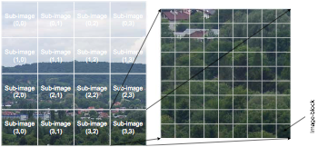
Three MPEG-7 Texture Descriptors
Texture – powerful low-level descriptor for image search and retrieval
Edge Histogram Descriptor (example provided)
Homogeneous Texture Descriptor
Texture Browsing Descriptor

Slide 12
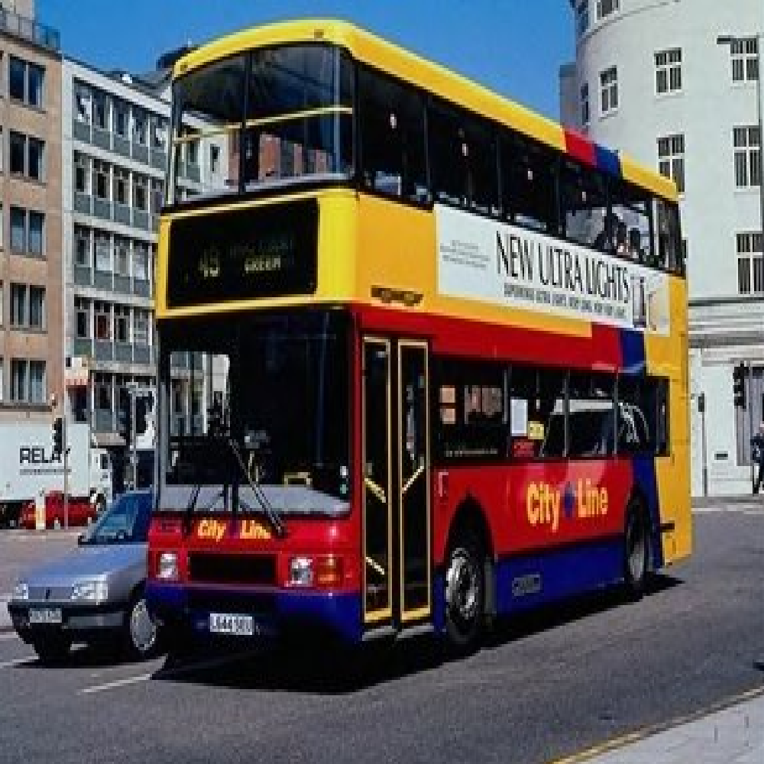
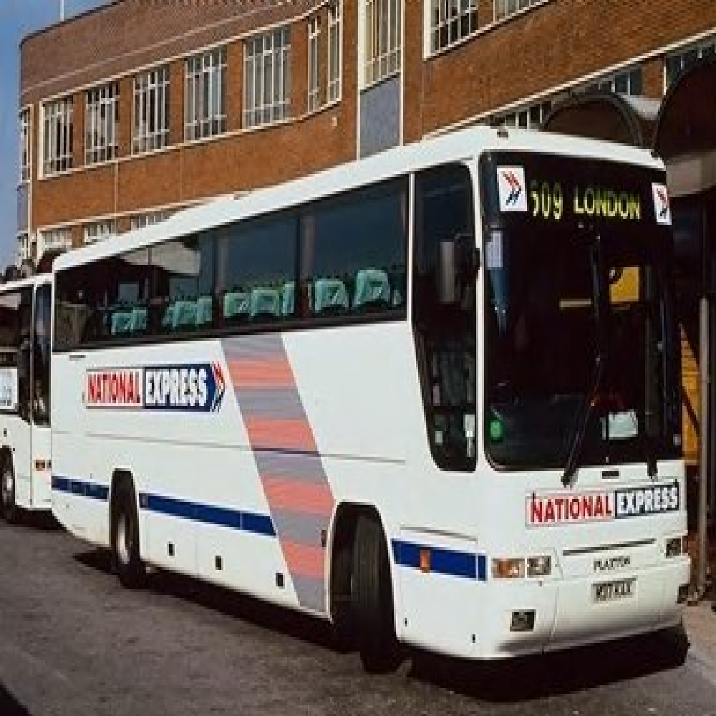
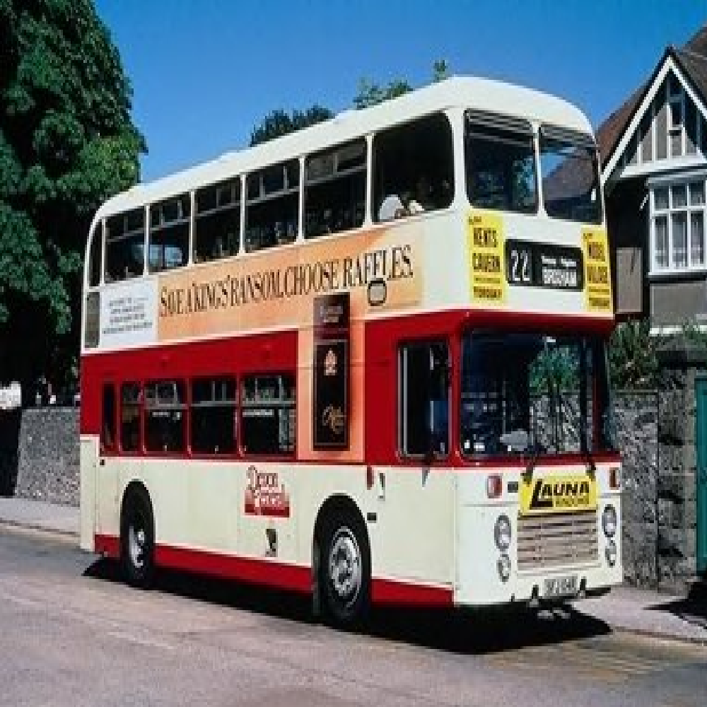
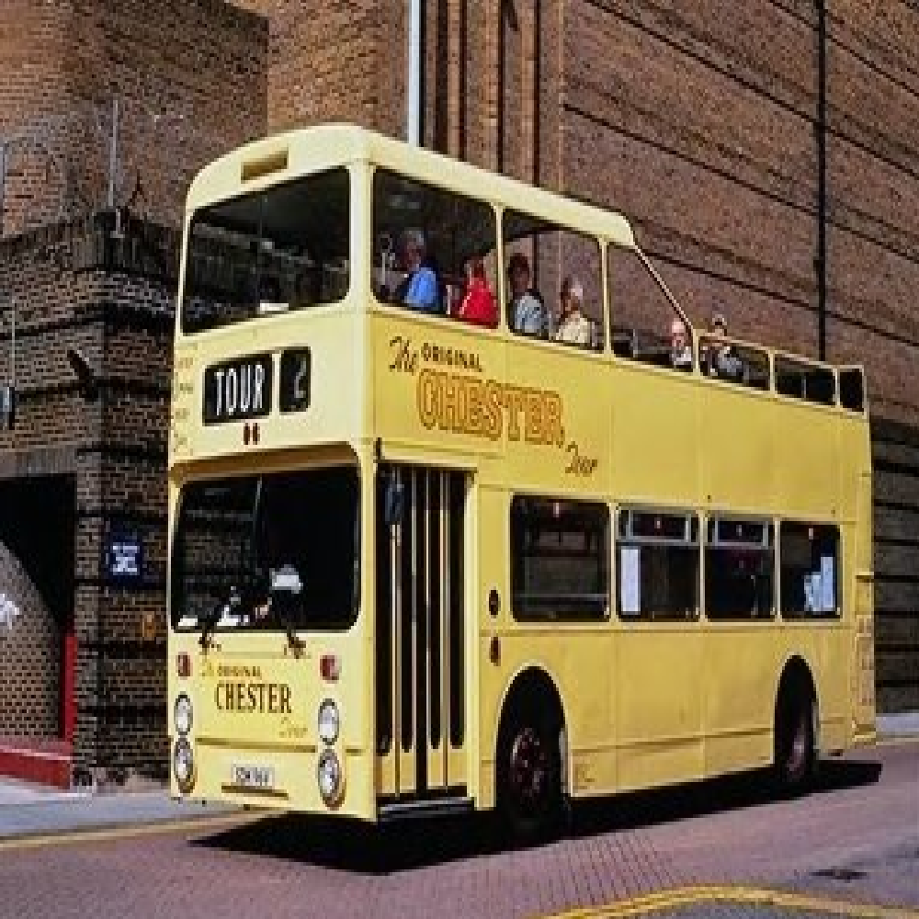
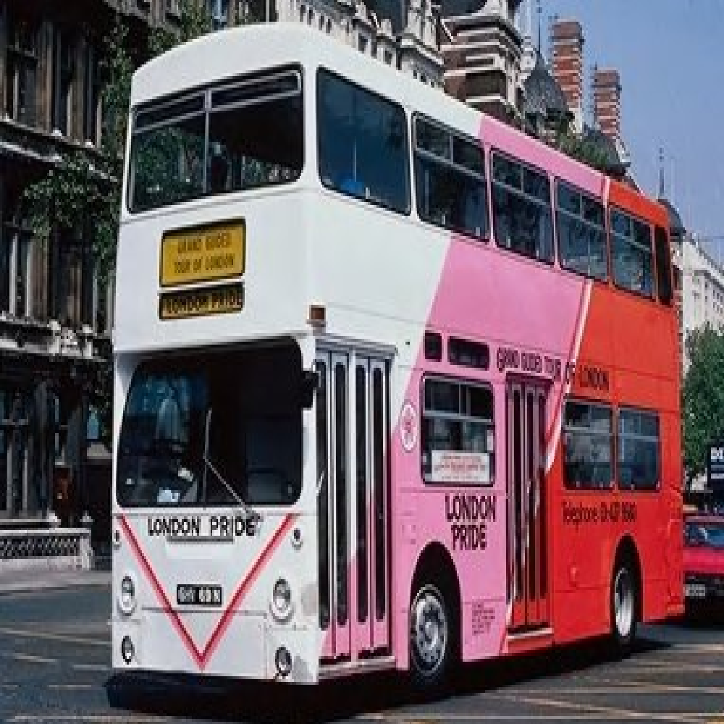
Examples of MPEG-7 Texture Descriptors Searching
Edge Histogram Descriptor
Homogeneous Texture Descriptor

Slide 13
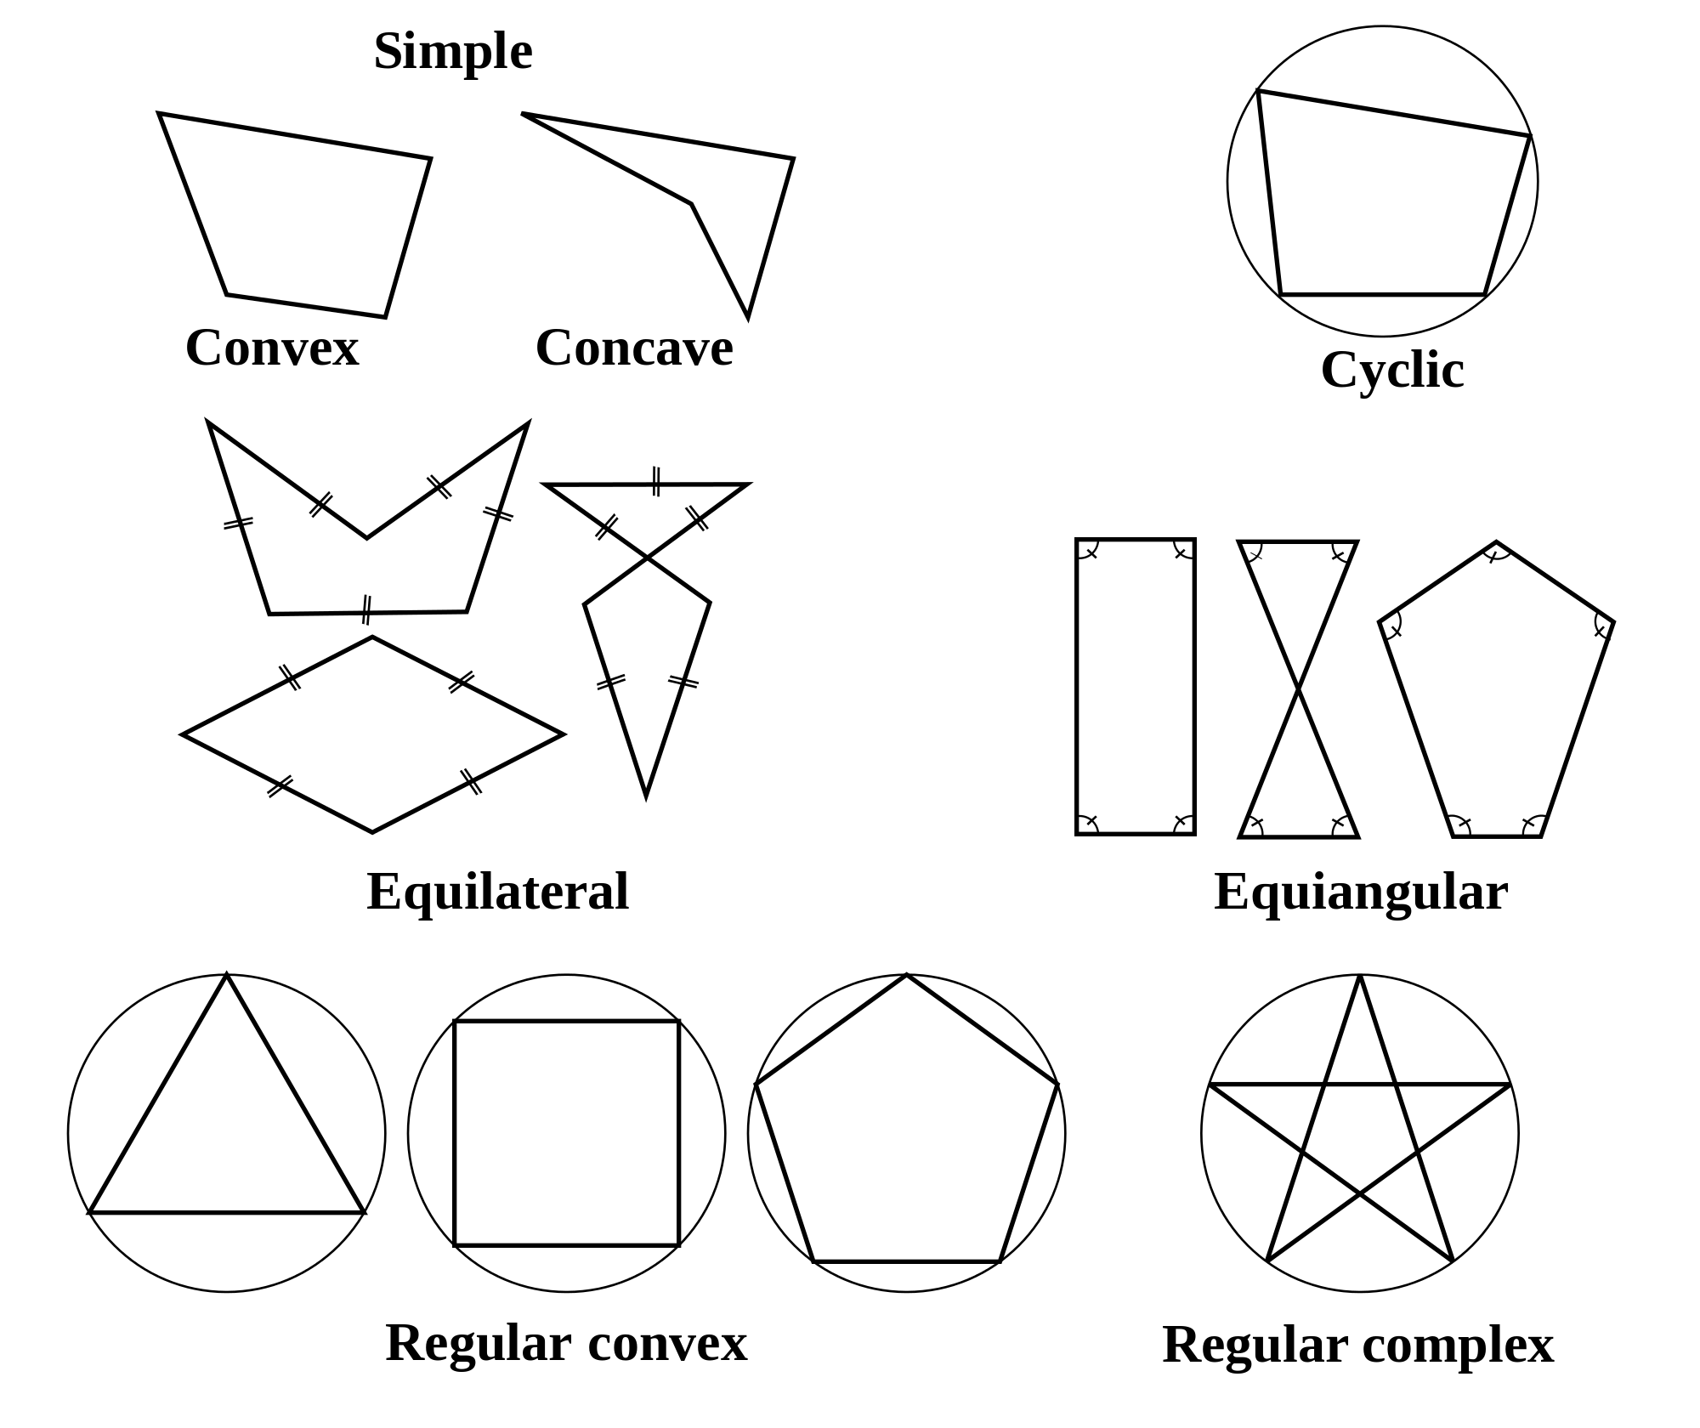
Four MPEG-7 Shape Descriptors
Shape features – relating to spatial arrangement of points (pixels) belonging to object or region
Region Shape Descriptor
Contour Shape Descriptor
Shape 3D Descriptor
Perceptual 3D Shape Descriptor

Slide 14
Thank You for Your Attention!

